Slide 1
Aligning Outcomes, Activities, & Assessments
Melodie J. Kolmetz, MPAS, PA-C, EMT-P

Slide 2
How did I learn about this topic?
EMS Provider x 30 years, 9 at the paramedic level
Full time PA Educator for 5 years
Master’s degree in PA Education from the University of Nebraska Medical Center
Doctoral Student in Curriculum, Instruction, and the Science of Learning at the University at Buffalo
https://blog.edpuzzle.com/teacher-life/hats-a-teacher-wears/

Slide 3
When you saw the title of this presentation, what one word came to mind?
Vote Trigger

Slide 4
Do You love learning outcomes and instructional objectives?
Vote Trigger

Slide 5
When planning courses and sessions, how do you use learning outcomes and instructional objectives?
1.
I utilize the ones provided by my institution.
0%
2.
I utilize the ones provided by the textbook publisher.
0%
3.
I write my own.
0%
4.
You mean someone actually uses those?
0%
Vote Trigger

Slide 6
My course/program is competency based.
1.
True
0%
2.
False
0%
3.
Competent at what?
0%
Vote Trigger

Slide 7
Background Information

Slide 8
Learning Outcomes
Participants will be able to develop a course plan. (Affective Domain)
Participants will be able to develop an outcomes matrix. (Metacognitive Domain)
Participants will be able to coordinate their course activities and assessments to map to learning outcomes. (Psychomotor)

Slide 9
Instructional Objectives
At the end of this session, participants will be able to:
identify the various types of assessments that can be utilized. (Cognitive Domain)
relate an educational activity to a learning outcome. (Knowledge Domain)
value non-traditional educational activities. (Interpersonal Domain)

Slide 10
But wait a minute….

Slide 11
Must have jargon…

Slide 12
Competencies
The medical knowledge; interpersonal, clinical, and technical skills; professional behaviors; and clinical reasoning and problem-solving abilities required for practice
Summative in nature and set the tone for what is required of the student upon completion of the program to enter clinical practice.
The abilities required for clinical practice

Slide 13
Competencies in Medical Education
The key qualities required from a program graduate:
Medical knowledge
Interpersonal skills
Clinical and technical skills
Patient care
Clinical reasoning
Problem-solving abilities

Slide 14
Learning Outcomes
Establish what the student must be able to do at the conclusion of a curricular component of the program.
A useful learning outcome should:
• Provide focused guidance for the development of the desired behavior
• Include specific verb, observable action
• State the desired level of performance

Slide 15
Instructional Objectives
Focus on content and skills important within each course and provide the details necessary to help the student progress towards the acquisition of learning outcomes.
Are observable actions or behaviors.
Are designed to guide students in their studies and or activities and may also aid faculty in developing appropriate educational experiences.

Slide 16
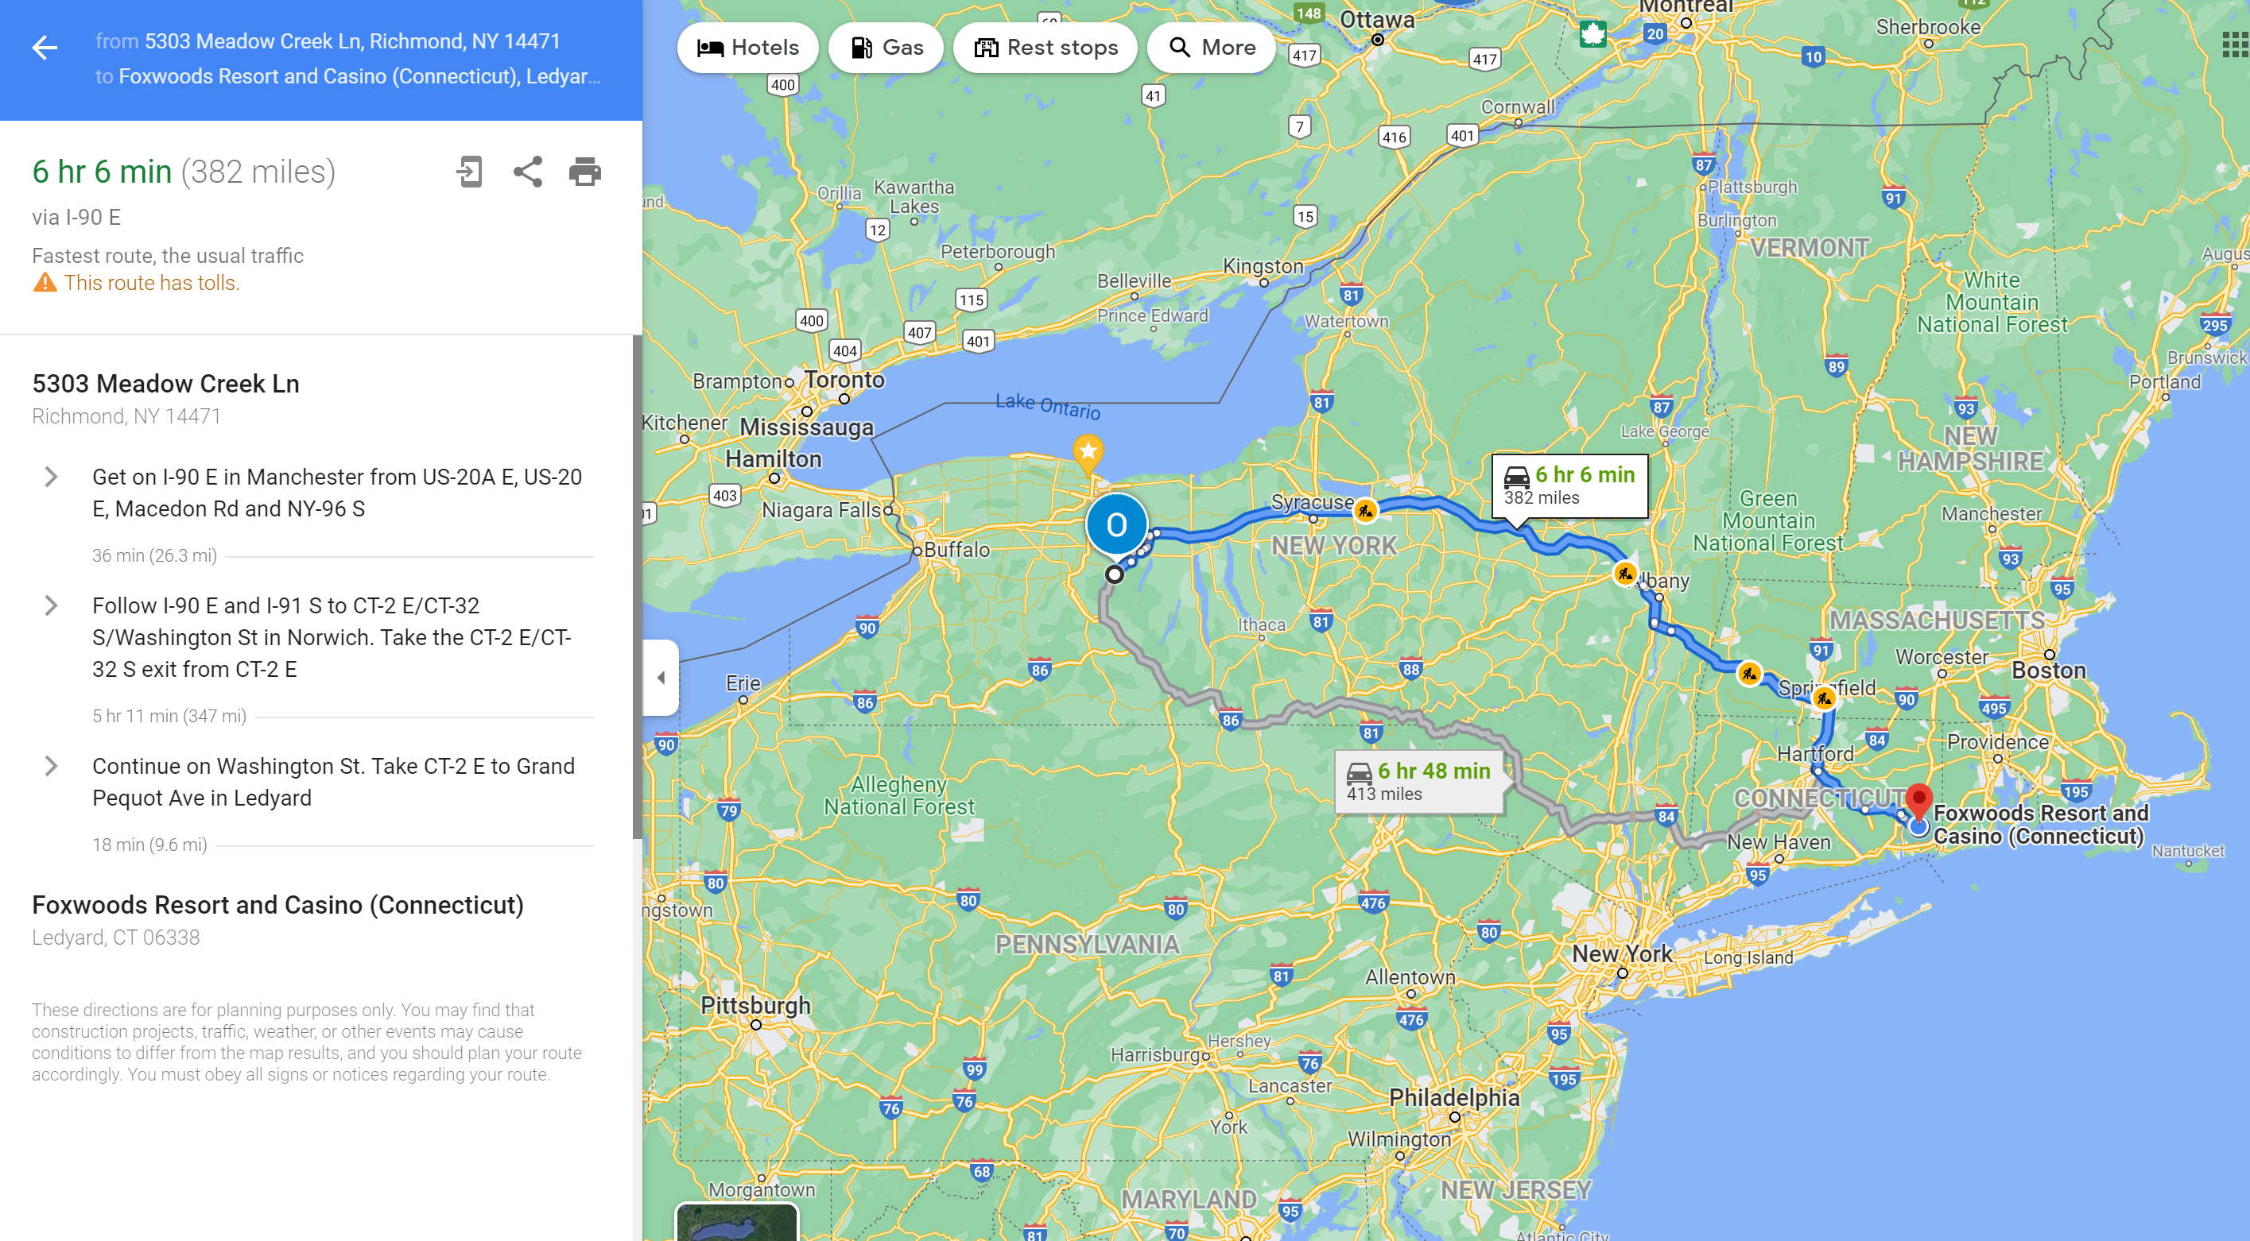
It Comes Together
Program Goals are data driven measures for program success
Google Map of the destination.
Competencies establish the target for the program.
Giant panorama photograph at the destination.
Instructional Objectives are the detailed steps of how to get there.
Driving directions.
Learning Outcomes are the proof of how trainees are reaching the target.
Selfies taken along the way.

Slide 17
Outcomes Domains
Here’s our friend Dr. Bloom:
Three domains, or categories, of educational activities:
Cognitive Knowledge or Mental Skills
Affective Attitude or Emotions
Psychomotor Skills or Physical Skills
Notes:
In 1956, educational psychologist Dr. Benjamin Bloom created a system to classify learning objectives into a series of learning domains that encourage teachers to think holistically about education. His system came to be known as Bloom’s Taxonomy. Much has been written about it, and it has been widely applied, including here at Davenport.

Slide 18
Bloom’s Taxonomy
https://cft.vanderbilt.edu/guides-sub-pages/blooms-taxonomy/

Slide 19
How valuable/important is Bloom's Taxonomy to you?
Average:
0
Vote Trigger

Slide 20
Simon Paul Atkinson Does it Better

Slide 21
More Domains!

Slide 22
Now What?

Slide 23
Begin With the End in Mind
Grant Wiggins and Jay McTighe
https://cft.vanderbilt.edu/guides-sub-pages/understanding-by-design/

Slide 24
Melodie’s Method
1. Consider the course goal-what do I want to accomplish?
How does that fit in to the curriculum, if appropriate?
2. What are my learning goals?
What do the learners need to know at the end of the session/course?
3. How much time do we have?
How many sessions will I have?
4. How will I assess if we met those goals?
What taxonomy does each goal fall in?
Make an outcomes matrix

Slide 25
Melodie’s Method
5. Plan the assessment(s).
How many formative assessments are needed?
What will the summative assessment consist of?
6. Design the assessment(s).
Atkinson can help.
7. Design each session.
What are the session objectives (AKA learning outcomes)?
8. Include multiple ways to present the material.
Lecture, podcasts, videos, cases, etc.
Can use a matric here, too.

Slide 26
Miller Helps

Slide 27
Assessment Ideas
Written papers.
Short-answer quizzes.
Free-response questions.
Homework assignments.
Lab projects.
Practice problems.
Group projects.

Slide 28
https://sijen.com/research-interests/taxonomies/cognitive-domain/

Slide 29
Name some common ways to assess the cognitive domain.
Vote Trigger

Slide 30
https://sijen.com/research-interests/taxonomies/affective-domain/

Slide 31
Name some common ways to assess the affective domain.
Vote Trigger

Slide 32
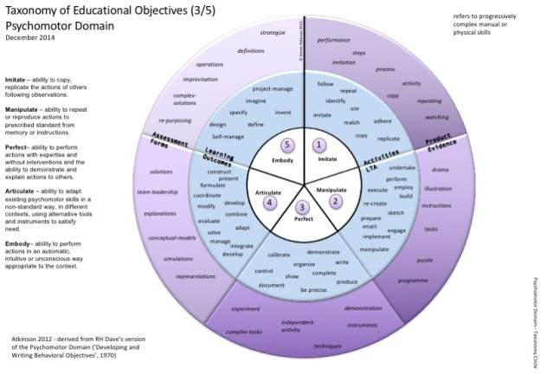
https://sijen.com/research-interests/taxonomies/psychomotor-domain/

Slide 33
Name some common ways to assess the psychomotor domain.
Vote Trigger

Slide 34
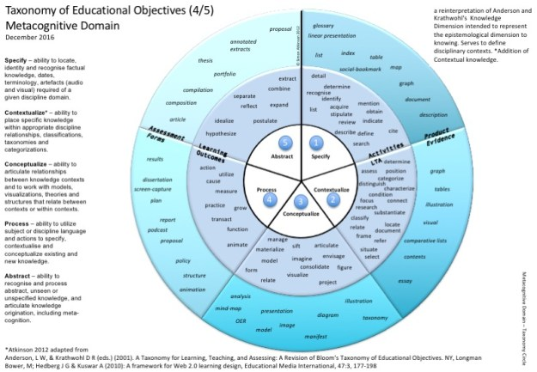
https://sijen.com/research-interests/taxonomies/metacognitive-domain/

Slide 35
Name some common ways to assess the metacognitive domain.
Vote Trigger

Slide 36
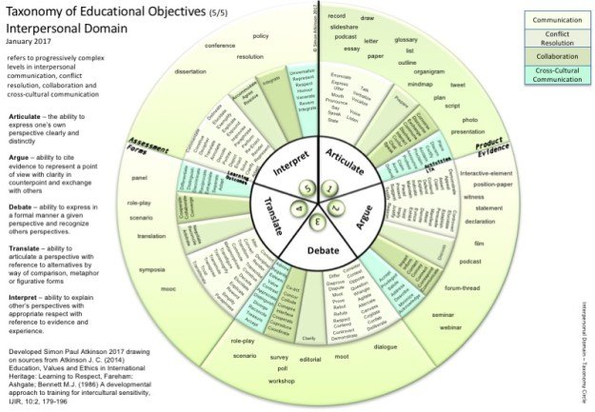
https://sijen.com/research-interests/taxonomies/interpersonal-domain/

Slide 37
Name some common ways to assess the interpersonal domain.
Vote Trigger

Slide 38
Wrap Up

Slide 39
Questions, Problems, Thoughts, Concerns?
Bring it on……

Slide 40
References
https://scholar.google.com/scholar_url?url=https://www.researchgate.net/file.PostFileLoader.html%3Fid%3D56692fe9614325a1458b459b%26assetKey%3DAS%253A305021168619522%25401449734121244&hl=en&sa=X&ei=Ds0NYZSUAcmUy9YPg5e2wAo&scisig=AAGBfm2i9oZdGO7qO0xOW10DA9cfbqIEfA&oi=scholarr
https://sijen.com/
https://cft.vanderbilt.edu/guides-sub-pages/understanding-by-design/
https://jaymctighe.com/resources/
https://onlinelearningconsortium.org/consult/olc-quality-scorecard-suite/

Slide 41
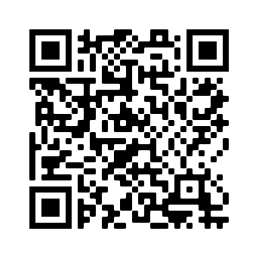
Thank you! Feedback is appreciated.
LINKEDIN Melodie-Kolmetz
TWITTER @AMedTypePerson
EMAIL melodie@amedicaltypeperson.com
PHONE 585-752-2092
This Photo by Unknown Author is licensed under CC BY-SA

