Slide 1
Intimate Partner Violence
Go Beyond Checking the box

Slide 2
Introduction

Slide 3
My Background
EMS Provider since 1991
NYS Paramedic since 2012
NYS CIC since 2011
Nationally certified PA since 1995
Clinical Practice-Mobile Surgical Services for Rochester Regional Health
Director of Didactic Education at developing Ithaca College PA program

Slide 4
Instructional Objectives
Objective 1: Recognize common signs and symptoms of intimate partner violence. Objective 2: Demonstrate non-judgmental communication skills when screening for IPV. Objective 3: Identify and utilize IPV resources that are available in their local community.

Slide 5
Disclaimer
Notes:
This discussion may make you uncomfortable. Feel free to step away if you need to.

Slide 6
A Case Study

Slide 7
The Life of Joy
25 year old female
Met her husband 6 years ago, married 2 years ago
He calls her frequently throughout the day to “check in”
Sometimes gets upset when she doesn’t answer
One day, she notices her computer isn’t working correctly-repair place tells her it has spyware
A few months later, she notices money missing from her checking account, her husband tells her the bank made an error
She is invited to go out with friends, her husband requests that she stay home for “date night”

Slide 8
Definition of IPV

Slide 9
Definition of IPV
Refers to a pattern of behaviors that one person in an intimate partner relationship uses against the other person in the relationship to try to establish and maintain power and control.
Involves current or previous:
Spouses
Romantic partners who live/lived together
Fiancés/Fiancées
Dating Partners

Slide 10
History of IPV
750 BCE – “Rule of Thumb”
300 CE – Constantine the Great’s demonstration
“Wife battering” not an official crime until 1945, however,…
1970s – research by data collection validated the problem of IPV
Shelter for battered women appeared
Terms such as woman battering and domestic violence emerged
- Indiana Coalition Against Domestic Violence, 1999

Slide 11
Consequences of IPV
Physical maladies
Mental disabilities
Unintended pregnancies
STIs
Lack of feeling safe
Lack of work productivity – lowered SES
Burden for society, > 8.3 million healthcare dollars each year
Notes:
(Non acute presentation) Chronic headaches, sleep and appetite disturbances, palpitations, chronic pelvic pain, urinary frequency or urgency, IBS, sexual dysfunction, abdominal symptoms, and recurrent vaginal infections.
How do you think an abusive partner limits healthcare (routine or urgent) and wellness?
--limits access to care, won’t allow the victim to take or obtain medications, there are missed appointments, lack of access to finances, lack of ability to communicate by phone, unable to use birth control

Slide 12
Risk Factors for IPV

Slide 13
Victims of IPV come from every:
Age group
Religion
Ethnic/racial group
Socioeconomic level
Educational background
Sexual orientation
There is no single profile of an abused woman or perpetrator

Slide 14
Victim Risk Factors
**Being a victim of child abuse or witnessing parental IPV
Age < 24 (here in NM 26-35)
Low self esteem
Poverty
Not being married
Having young children in the home
Having multiple sexual partners
Pregnancy (yes and no)
History of being raised with violence at home

Slide 15
Victim Risk Factors
Ethnicity
Higher prevalence, incidence and recurrence of IPV among African American and Hispanics couples than White couples.
Special populations
immigrant women, women with disabilities, the elderly
Alcohol consumption and alcohol problems
Less education
Living within a community or family with male dominant norms

Slide 16
Characteristics of Perpetrators
26-35 years old
Presence of high levels of hostility
Low level of assertiveness
High need for control
Impulsiveness
Inability to regulate behavior such as aggression

Slide 17
Risk Factors for Homicide
Abuse in a previous relationship
Leaving the abuser, or even the threat of leaving
Stalking
Being strangled prior
Availability of handguns and other weapons, especially when coupled with ETOH
Perpetrator’s change in behavior
Loss in control over the victim
Barriers to help
Sheehan, et. al, (2015)

Slide 18
Stories from Family Members of IPV Homicide Victims
She couldn’t escape him no matter where she moved
There was an increase in their arguing; she told him their marriage was over
Extreme jealousy
Barriers to help
By perpetrator
Isolation
By the justice system, social and mental health organizations
By healthcare providers

Slide 19
Patterns of IPV

Slide 20
Methods of Control
Physical abuse:
Hitting, pushing
Shoving, slapping, punching
Holding or restraining
Strangling, choking
Inflicting bruises
Welts and lacerations
Dragging, pulling by hair
Restraining
Marking, branding

Slide 21
Methods of Control
Emotional abuse:
Threatening, intimidation
Humiliation
Extreme jealousy/possessiveness
Threatening acts of violence
Constant criticizing
Insulting and belittling
Ignoring or dismissing the victim
Denying, minimizing and blaming
Invading privacy

Slide 22
Methods of Control
Sexual abuse:
Coercing victim to have sex
Making victim watch pornographic movies
Sexually transmitted diseases
Demanding sexual photos
Using date rape drugs
Sabotaging birth control

Slide 23
Methods of Control
Financial abuse:
Withholding money
No access to bank accounts/ATM and credit cards
Ruining victim’s credit
Taking pay check
Gambling

Slide 24
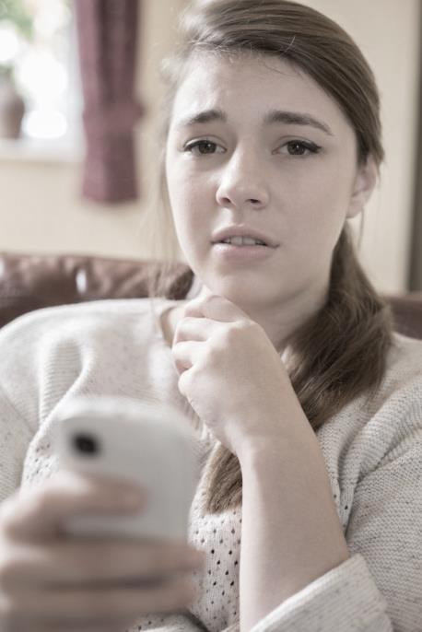
Methods of Control
Technology abuse:
Tracking location
Demanding check-ins
Excessive texts
Spyware
Spoofing, catfishing
Monitoring communications
Posting on Facebook and social media

Slide 25
Methods of Control
Legal abuse:
Constant threats to gain custody of children
Excessive filing of motions at court
Using parental rights to contact victim
Reports to child protective services

Slide 26
IPV in Specific Populations

Slide 27
Frequency of IPV
Experiences of IPV are reportedly 2 to 4x more frequently by respondents identifying as:
LGBTQ
Of transgender experience and non-binary gender
Multi-racial nH/nL, American Indian/Alaska Native, Black nH/nL, Asian nH/nL, and Hispanic/Latinx
Having a disability

Slide 28
IPV and Pregnancy
More likely to escalate and experience all and more severe forms of violence
3-fold risk of being murdered
Increased risk for complications during pregnancy
Notes:
Risks during pregnancy: antepartum hemorrhage, intrauterine growth restriction, fetal fracture, poor pregnancy weight gain, perinatal death, low birthweights, and preterm births
**Pregnant women screened for IPV are less likely to have preterm births, low birth weight infants, and higher Apgar scores than pregnant women not screened for IPV

Slide 29
Consequences of IPV

Slide 30
Health Effects of IPV
Injuries
Headaches
Insomnia
Chronic pain
Choking sensations
Hyperventilation
Gastrointestinal symptoms
Chest pain
Back pain
Pelvic pain
TBI
Nonfatal strangulation
Unplanned pregnancies/pregnancy complications
STIs
Substance use disorders

Slide 31
Child Witnesses
1/3 of reported IPV cases involved at least 1 child witness
1/3 of the children experienced physical abuse, 15% experienced sexual abuse from the offender
Children who witness abuse are:
3x more likely to think about suicide and be told they have a substance abuse problem
4x more likely to experience child abuse
4x more likely be told they have a mental illness and attempt suicide
six times more likely to be abused as an adult
Caponera, 2016

Slide 32
Effects of Witnessing IPV as Children
Risk of becoming a future IPV victim or perpetrator
Aggression
Disengagement
School absence
Depression
PTSD
Poor self-image
Poor health
Notes:
However, a strong social support system for both the mother and child were protective and increased their resilience

Slide 33
Screening for IPV

Slide 34
Practitioner Barriers
Lack of awareness and education
Not wanting to open Pandora’s box
Uncertain of how to intervene
Protecting oneself so not to listen to painful depressing events
Feeling of helplessness at not being able to fix or change the situation
Time challenge
Notes:
How much education and/or training in IPV have most providers had?

Slide 35
Role (Responsibility) of the Provider
Screen
Understand who is at risk of becoming a victim
Assess level of danger
Give appropriate and safe advice
Refer to local agencies
Identify other family members at risk, especially children

Slide 36
Validated Screening Tools
Abuse Assessment Screen (avail in Spanish)
5 questions
Danger Assessment
15 items to assess danger of homicide (available in Spanish)
HITS (hurt, insult, threaten, and scream)
4 items
WAST (Quick!)
Short version (2 items)
Spanish version (8 items)
Basile, Hertz, Back, 2007
https://www.cdc.gov/violenceprevention/pdf/ipv/ipvandsvscreening.pdf

Slide 37
WAST Screening Questions | Option 1 | Option 2 | Option 3
In general, how would you describe your relationship? | A lot of tension | Some tension | No tension
Do you and your partner work out arguments with: | Great difficulty | Some difficulty | No difficulty
WAST Post-Screening Survey
Do arguments ever result in you feeling down or bad about yourself | Often | Sometimes | Never
Do arguments ever result in hitting, kicking, or pushing? | Often | Sometimes | Never
Do you ever feel frightened by what your partner says or does? | Often | Sometimes | Never
Has your partner ever abused you physically? | Often | Sometimes | Never
Has your partner ever abused you emotionally? | Often | Sometimes | Never
Has your partner ever abused you sexually? | Often | Sometimes | Never

Slide 38
Assessing Immediate Risk of Violence
Has the physical violence happened more often or gotten worse in the last 6 months?
Has he/she ever used a weapon or threatened you with a weapon
Has he/she ever tried to strangle you?
Do you believe he/she could ever kill you?
Has he/she ever beaten you when you were pregnant?
Is he/she violently and constantly jealous of you?
“Yes” answers to at least 3 of these questions
may indicate immediate danger of violence

Slide 39
Safety Plans for IPV

Slide 40
The Frequently Told Story:
Seduction and Charm
Interested in “me”, supportive, and loving…
Intimacy, the importance of “us”, sacred relationship…
Isolation
Move away from others
Less contact with family and friends
Limit access to finances or resources
Violence or the Threat of Violence
Availability of weapons
Physical or sexual assault

Slide 41
“Why stay?”
Hope that things will get better.
On average, victims deal with IPV 5-7x before leaving
Disappointing friends, family or community.
Lack of resources to care for self or child(ren).
Religious or cultural beliefs.
Immigration Status.
Belief that they can keep themselves and child(ren) safe.
Fear of being hurt or killed.

Slide 42
It’s Easy to Say “Just Leave”
Despite the common belief that survivors of intimate partner violence (IPV) can exercise control over their circumstances, access to social and economic resources affects survivors' ability to attain safety.
There is also a tendency to focus on physical injury as the only impact of IPV, however, IPV also affects mental health and multiple other life domains.
Some groups are at higher risk, but IPV affects people of all backgrounds (genders, races, ethnicities, ages, sexual orientations, disability statuses, educational backgrounds, incomes, etc.).

Slide 43
Significant Worries
Housing, utilities, debt, vehicles, insurance, and school tuition/daycare expenses
Household, medical/healthcare, technology, and childcare needs
Fear of loosing the partner who at this point may be the only one providing for her and/or children
Isolated without transportation
Fear the partner will find out and retaliate
Poor experiences in the past when the abuse has been divulged
Embarrassed
Fear of being deported
Having grown up with a culture of family violence and not recognizing it as wrong

Slide 44
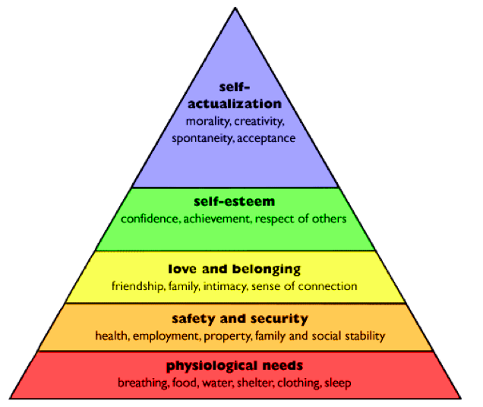
Maslow’s Hierarchy of Needs

Slide 45
Key Components
Intimate Partner Violence
Basic Needs
Mental Health
Employment
Housing
Healthcare Access
Violence Support Services

Slide 46
Talking with your patient (victim)
Screen privately (alone) and assure confidentiality
Talk in a manner that is understandable and that you are comfortable with
Listen without interruption
Provide a nonjudgmental and supportive environment
Notes:
What should you do if you suspect IPV but she doesn’t disclose it?

Slide 47
You do not need to:
Solve the victim’s problems
Convince the victim to leave a violent relationship
Convince the victim to go to other services such as the police and the courts
Ask detailed questions that force the victim to relive painful events
Ask the victim to analyze what happened or why
Pressure the victim to tell you her feelings and reactions to an event
These actions could cause more harm than good

Slide 48
EMPOWER
Empathic listening
Making time to properly document findings
Providing information about IPV
Offering option and choices
Working with an abuse specialist
Encouraging planning for safety and support
Referring to local services

Slide 49
Plan
Listen
Inquire about needs and concerns
Validate
Enhance safety
Support

Slide 50
Safety Plan Discussion
Safe place to go
If you need to leave your home in a hurry, where could you go?
Planning for children
Would you go alone or take your children with you?
Transport
How will you get there
Items to take with you
Important documents, immunization records, keys, money, clothes, essential items. Do you have access to money if need to leave in an hurry?
Support of someone close by
Is there a neighbor you can tell about the violence who can call the police or come with assistance for you if they hear sounds of violence coming from your home?

Slide 51
Documentation
Tell what you want to document and ask permission to do so
Use victim’s words, not yours when possible
If you take pictures, include pt.’s name, location of injury and name of photographer
Enter in the EMR any health complaints, signs, symptoms
Measure and describe injuries
Don’t document heat of the moment statements such as “I swear I’ll kill him”

Slide 52
Back to Our Case Study

Slide 53
The Life of Joy
Her husband claims he is ready to start a family
She expresses uncertainty
One day, she can’t find her birth control pills and she assumes she misplaced them
One day, she tries to reach him at work and finds out that he isn’t there
When he comes home, she confronts him and tells him that she is leaving
He becomes violent, punching a hole in the wall
Were there signs of IPV in this relationship?
Is she in immediate danger?

Slide 54
In Conclusion

Slide 55
In Summary
IPV survivors are more likely to experience:
Job loss, reduction in work hours, and the need to take leave
Concerns about housing stability, paying expenses, and meeting basic needs
Poor mental health AND face structural barriers to accessing needed healthcare
Lack of social and economic resources and access to care both exacerbate the impacts of IPV and make survivors more vulnerable to further abuse
Continuing digital outreach and service provision approaches may expand access to resources for survivors in the context of a pandemic and after; access to technology and broadband is critical

Slide 56
Options for Mental Health Support
Meeting in-person with a mental health professional for individual or group mental health therapy
Talking to a mental health professional via video chat
Using an app on a cell phone or tablet to obtain mental health support
Talking to a mental health professional over the telephone
Information on seeing a therapist
Attending a support group via an on-line platform

Slide 57
Validated Screening Tools
Abuse Assessment Screen ACOG
https://www.acog.org/About-ACOG/ACOG-Departments/Women-with-Disabilities/Abuse-Assessment-Screen
Danger Assessment Tool
https://wwwn.cdc.gov/wpvhc/Course.aspx/Supplemental/Unit6_8_Supp
HITS
https://www.researchgate.net/profile/Kevin_Sherin/publication/13616105_HITS_A_short_domestic_violence_screening_tool_for_use_in_a_family_practice_setting/links/02e7e538a4f3a20d28000000.pdf

Slide 58
References
https://law.uq.edu.au/research/dv/using-law-leaving-domestic-violence/case-studies
https://www.cdc.gov/violenceprevention/pdf/ipv/ipvandsvscreening.pdf
https://www.ahrq.gov/ncepcr/tools/healthier-pregnancy/fact-sheets/partner-violence.html

