Slide 1
Metacognition for EMS Educators
Melodie J. Kolmetz, MPAS, PA-C, EMT-P, CIC

Slide 2
A Little Bio

Slide 3
A Little About Me
EMS Provider for 30 years
Paramedic for 10 years
PA for 26 years
Full-time PA educator
Part-time EMS Educator
Mobile Surgical Services PA
Paramedic in Suburban and Rural areas of NY state
Doctoral student in Curriculum, Instruction, and the Science of Learning
I LOVE Learning!

Slide 4
Introduction

Slide 5
Instructional Objectives
At the end of this presentation, the learner will be able to:
Discuss metacognition and how it can benefit learners.
Select metacognitive activities that will engage learners.
Implement metacognitive activities in EMS educational practice.
Share the benefits of metacognition with other EMS educators.

Slide 6
What is Metacognition?

Slide 7
Metacognition is:
Learning about learning.
Knowledge and understanding of what we know and how we think, including the ability to regulate our thinking as we work on a task.
Metacognition describes the processes involved when learners plan, monitor, evaluate and make changes to their own learning behaviors.
A learning domain different from cognitive, psychomotor, and affective.

Slide 8
Importance of Metacognition
Shapes active rather than passive learners
Gives students a sense of control over learning
Helps to promote “deep learning”
Helps promote retention

Slide 9
Misconceptions
Thinking skills are not the same as:
Intelligence
Being “brilliant” at school work
Gathering lots of information
Being good at speaking out in class
Thinking is a skill that can be learned, practised, developed and improved.
It does not happen naturally, it must be cultivated!

Slide 10
The Learning Cycle

Slide 11
Metacognitive Awareness Questionnaire
Metacognitive Awareness of Reading Strategies (MARSI)
30 items – global, problem-solving, support strategies
https://www.nwfsc.edu/wp-content/uploads/2017/10/Marsi-test.pdf
Metacognitive Awareness Inventory (MAI)
52 items, self scoring scale included
https://www.rcsj.edu/Tutoring-site/Gloucester-site/Documents/Metacognitive%20Awareness%20Inventory.pdf

Slide 12
What About Theory?

Slide 13
First Came Bloom’s

Slide 14
What About Bloom’s and Metacognition?

Slide 15
Can’t Forget Miller
Miller’s & Metacognition
Does | Writes the OSCEs
Shows How | Completes OSCEs with self/peer evaluation
Knows How | Writes practice questions/cases
Knows | Completes practice MCQ Exams

Slide 16
The New Guy is Atkinson
Specify
Contextualize
Conceptualize
Process
Abstract

Slide 17
Metacognition and Note Taking Strategies

Slide 18
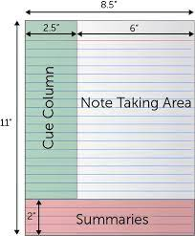
The Cornell Method
Provides a systematic format for condensing and organizing notes without laborious recopying.
Notes are written in the main space and the left side space is used to label each idea and detail with a key word or cue.
A summary is compiled at the bottom.

Slide 19
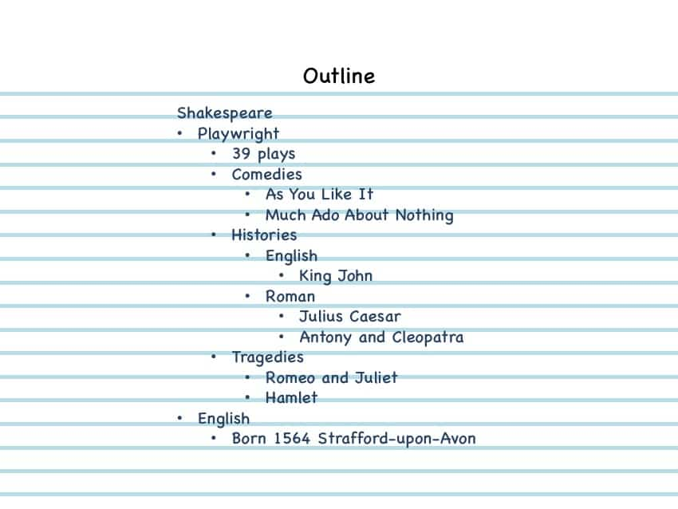
The Outlining Method
General information begins at the left.
More specific groups of facts are indented to the right.
Relationships are indicated with indents.
No need for numbers, letters, or Roman numerals.
May not work well for science classes or math classes.

Slide 20
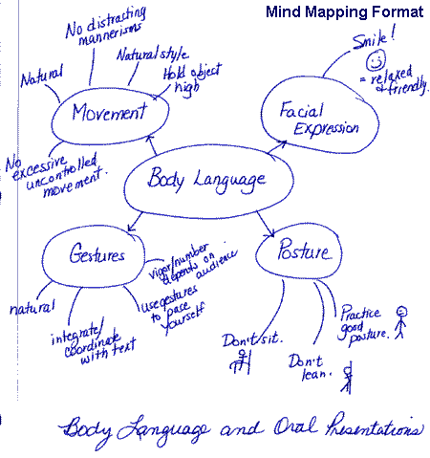
The Mapping Method
Uses comprehension and concentration skills.
Each fact or idea relates to other facts or ideas.
Graphic representation of the content.
Maximizes active participation.
Emphasizes critical thinking.

Slide 21
The Charting Method
Helps when heavy content comes fast.
Lends itself to study and memorization.
Excellent for comparing and contrasting.

Slide 22
The Sentence Method
Each new thought is written on a separate line.
Helpful when the instructor presents points but not clear relationships.
Good for content-heavy lectures.

Slide 23
Classroom Metacognitive Strategies

Slide 24
3-2-1 Summary
What are three ideas that have captured your attention from today's class?
What are two questions that you are still thinking about related to these topics?
What one thing will you remember long after this class is over?

Slide 25
Minute Paper
Please answer each question in one or two sentences:
What is the most useful, meaningful, or intriguing thing you learned from today's class discussion?
What questions do you have about today's discussion that you would like answered before we move on?

Slide 26
Dipsticks
Write a letter to a friend which explains the key ideas
Draw a sketch which represents new knowledge gained
Think, pair, share with a partner

Slide 27
T-A-G Feedback
Tell your peer something they did well
Ask a thoughtful question
Give a positive suggestion

Slide 28
Videos
Learners make short (1-3 minute) videos explaining key concepts
Educator can review and provide feedback
Peers can review and provide feedback

Slide 29
Metacognitive Strategies for Studying

Slide 30
Strategy | How to Use | When to Use | What is it for?
Skim/Survey | Search for headings, highlighted words previews, summaries | Before you read a long piece of text | Gives an overview of the key concepts, helps you to focus on the important points
Slow down | Stop, read and think about information | When information seems important. If you realise you don’t understand what you have just read. | Improves your focus on important information.
Activate prior knowledge | Stop and think about what you already know about a topic. | Before you read something or do an unfamiliar task. | Makes new information easier to remember and allows you to see links between subjects. Information is less daunting if you already know something about the topic
Fit ideas together | Relate main ideas to one another. Look for themes that connect the main ideas, or a conclusion | When thinking about complex information, when deep understanding is needed. | Once you know how ideas are related they are easier to remember than learning as if they are separate facts. Also helps to understand them more deeply
Draw Diagrams | Identify main ideas, connect them, classify ideas, decide which information is most important and which is supporting | When there is a lot of factual information that is interrelated | Helps to identify main ideas and organise them into categories. Reduces memory load. May be easier to visualise

Slide 31
Concept Maps
Minimal writing
Precision of expression required
Indicates understanding of a topic
Opportunity for planning, revising & evaluation
Helpful study guides

Slide 32
Electronic Concept Map
https://coggle.it/
https://www.mindmup.com/
https://www.mindmeister.com/

Slide 33
Chapter Map
Title of Chapter
Primary Headings
Subheadings
Secondary Subheadings

Slide 34
Compare and Contrast
Concept #1
Concept #2
How are they similar?
How are they different?

Slide 35
Metacognitive Strategies for Learners

Slide 36
The Study Cycle
4 Reflect
3 Review
Preview
Preview before class – Skim the chapter, note headings and boldface words, review summaries and chapter objectives, and come up with questions you’d like the lecture to answer for you.
4 Reflect
Attend
Attend class – GO TO CLASS! Answer and ask questions and take meaningful notes.
Review after class – As soon after class as possible, read notes, fill in gaps and note any questions.
Review
Study – Repetition is the key. Ask questions such as ‘why’, ‘how’, and ‘what if’.
Intense Study Sessions* - 3-5 short study sessions per day
Weekend Review – Read notes and material from the week to make connections
Study
Assess your Learning – Periodically perform reality checks
Am I using study methods that are effective?
Do I understand the material enough to teach it to others?
Assess
*Intense Study Sessions
1 | Set a Goal | (1-2 min) | Decide what you want to accomplish in your study session
2 | Study with Focus | (30-50 min) | Interact with material- organize, concept map, summarize, process, re-read, fill-in notes, reflect, etc.
3 | Reward Yourself | (10-15 min) | Take a break– call a friend, play a short game, get a snack
4 | Review | (5 min) | Go over what you just studied
Center for Academic Success
B-31 Coates Hall ▪ 225.578.2872 ▪www.cas.lsu.edu

Slide 37
What tools do I already have?
The syllabus!
A learning outcome describes the overall purpose or goal from participation in an educational activity. Courses should be planned with a measurable learning outcome in mind.
Learning objectives are used to organize specific topics or individual learning activities to achieve the overall learning outcome.
Textbook chapters-terminology, self-check questions

Slide 38
Planning
What is the nature of the task?
What is my goal?
What kind of information and strategies do I need?
How much time and resources do I need?

Slide 39
Information Management
Which of the following might be helpful to me?
Glossary
List
Concept map
Table
Graph
Illustration
Diagram

Slide 40
Monitoring
Do I have a clear understanding of what I am doing?
Does the task make sense to me?
Am I reaching my goals?
Do I need to make changes?

Slide 41
Debugging
Who can I ask for help?
Can I change strategies?
Do I need to return to the information source?

Slide 42
Evaluating
Have I reached my goal?
What worked?
What didn’t work?
Would I do things differently the next time?

Slide 43
Evaluating Your Performance

Slide 44
Evaluating Your Own Performance
The role of motivation: mastery vs. performance
Refer to learning objectives!
Evaluate your work – and follow up knowledge gaps
Make time for regular reflection

Slide 45
Questions for Remembering
What happened after...?
How many...?
What is...?
Who was it that...?
Can you name ...?
Find the definition of…
Describe what happened after…
Who spoke to...?
Which is true or false...?

Slide 46
Questions for Understanding
Can you explain why…?
Can you write in your own words?
How would you explain…?
Can you write a brief outline...?
What do you think could have happened next...?
Who do you think...?
What was the main idea...?
Can you clarify…?
Can you illustrate…?
Does everyone act in the way that …….. does?

Slide 47
Questions for Applying
Do you know of another instance where…?
Can you group by characteristics such as…?
Which factors would you change if…?
What questions would you ask of…?
From the information given, can you develop a set of instructions about…?

Slide 48
Questions for Analyzing
Which events could not have happened?
If. ..happened, what might the ending have been?
How is...similar to...?
What do you see as other possible outcomes?
Why did...changes occur?
Can you explain what must have happened when...?
What are some or the problems of...?
Can you distinguish between...?
What were some of the motives behind..?
What was the turning point?
What was the problem with...?

Slide 49
Questions for Evaluating
Is there a better solution to...?
Judge the value of... What do you think about...?
Can you defend your position about...?
Do you think...is a good or bad thing?
How would you have handled...?
What changes to.. would you recommend?
Do you believe...? How would you feel if. ..?
How effective are. ..?
What are the consequences..?
What influence will....have on our lives?
What are the pros and cons of....?
Why is ....of value?
What are the alternatives?
Who will gain & who will loose?

Slide 50
Questions for Creating
Can you design a...to...?
Can you see a possible solution to...?
If you had access to all resources, how would you deal with...?
Why don't you devise your own way to...?
What would happen if ...?
How many ways can you...?
Can you create new and unusual uses for...?
Can you develop a proposal which would...?

Slide 51
Resources
www.cas.lsu.edu
https://www.ldatschool.ca/metacognitive-strategies-or-thinking-about-my-thinking/
https://www.cultofpedagogy.com/note-taking/
https://lsc.cornell.edu/notes.html
https://lsc.cornell.edu/how-to-study/
https://ciel.viu.ca/sites/default/files/metacognitive_awareness_inventory.docx
https://mygrowthmindsethome.files.wordpress.com/2019/03/blooms-taxonomy.pdf

Slide 52
References
Hong, W. H., Vadivelu, J., Daniel, E. G. S., & Sim, J. H. (2015). Thinking about thinking: changes in first-year medical students’ metacognition and its relation to performance. Medical education online, 20(1), 27561.
Medina, M. S., Castleberry, A. N., & Persky, A. M. (2017). Strategies for improving learner metacognition in health professional education. American journal of pharmaceutical education, 81(4).
Siqueira, M. A. M., Gonçalves, J. P., Mendonça, V. S., Kobayasi, R., Arantes-Costa, F. M., Tempski, P. Z., & Martins, M. D. A. (2020). Relationship between metacognitive awareness and motivation to learn in medical students. BMC Medical Education, 20(1), 1-10.
Stark, M., & Fins, J. J. (2014). The ethical imperative to think about thinking: diagnostics, metacognition, and medical professionalism. Cambridge Quarterly of Healthcare Ethics, 23(4), 386-396.
Tanner, K. D. (2012). Promoting student metacognition. CBE—Life Sciences Education, 11(2), 113-120.

Slide 53
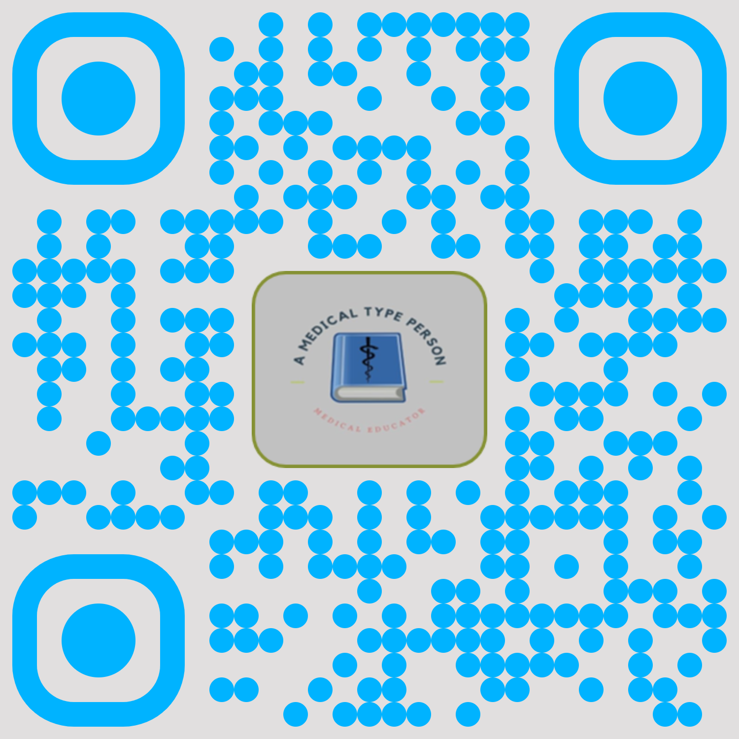
Thank you!
Melodie J. Kolmetz, MPAS, PA-C, EMT-P
melodie@amedicaltypeperson.com
www.amedicaltypeperson.com
@AMedTypePerson
Melodie-Kolmetz

